Slide 1


Slide 2

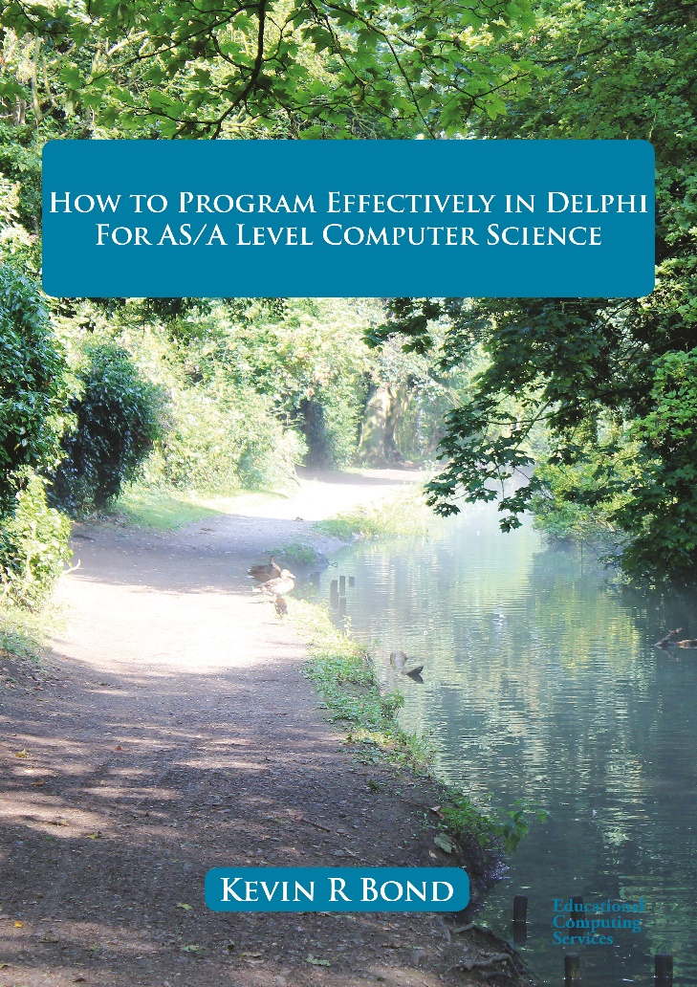
Coding Boot Camp 2022
How to Program Effectively in Delphi for AS/A Level Computer Science
By Kevin R Bond
Available in both print and pdf formats from
https://www.educational-computing.net
Main site for information
http://www.educational-computing.co.uk
Length =1200 pages.
Suitable for all levels from beginner to advanced developer

Slide 3
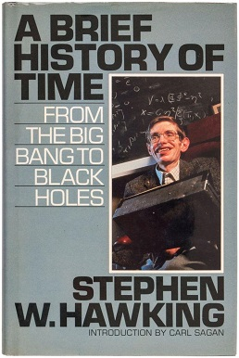

What is time – what this talk is not about?
The ARROW Of TIME
The existence of a thermodynamic arrow of time implies that the system is highly ordered in one time direction only, which would by definition be the "past“ – you can’t unscramble eggs
Entropy increases when a substance is broken up into multiple parts
As one goes "forward" in time, 2nd Law of Thermodynamics says:
the entropy of an isolated system can increase, but not decrease.
Entropy measurement is a way of distinguishing the past from the future
Logic level
Time/s
Count pulses/clock ticks
Know pulses/clock ticks per second

Slide 4
Overview
How to use a timing component, TTimer, from the Vcl.ExtCtrls unit and the FMX.Types unit, to create an event that can be responded to
How to obtain a measurement of a time interval using
GetTickCount and GetTickCount64 from the WinAPI.Windows unit
TStopwatch, a high resolution timer, from the System.Diagnostics unit
How to obtain the current date and time using the TDateTime data type from the System Unit
Working with dates and times in Delphi using date and time routines found in the System. System.SysUtils and System.dateUtils units

Slide 5
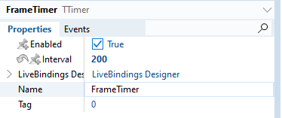
Using TTimer from Vcl.ExtCtrls unit
The standard VCL TTimer component is a wrapper for the Windows API timer functions SetTimer and KillTimer. TTimer simplifies the processing of the WM_TIMER messages by converting them into OnTimer events. A timer based on WM_TIMER message processing cannot provide a resolution better than 10 milliseconds.
Procedure TMainForm.FrameTimerTimer(Sender: TObject);
Begin
MediaPlayerJungleSounds.Play;
Counter := (Counter + 1) Mod 42;
NumberString := '00' + IntToStr(Counter + 16);
FileName := 'IMGP' + NumberString;
MainForm.Caption := FileName;
ImageOrangutan.Stretch := True;
ImageOrangutan.Picture.LoadFromFile('Z:\ProductionChapters\DelphiBook\Code\Chapter1\Images\' + FileName + '.jpg');
End;
Notes:
Integral Solutions Ltd (ISL) – Poplog = POP 11, Prolog
Clementine (Predictive Analytics Capabilities) sold to SPSS Inc., which sold to IBM Clementine is now IBM SPSS Modeler Professional A demo. It illustrates a class of applications of AI in a business context.

Slide 6
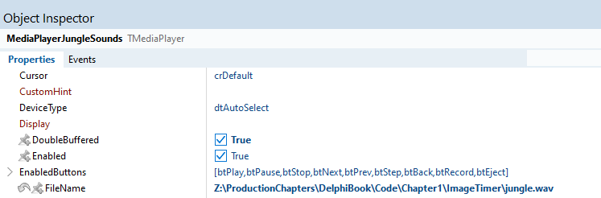
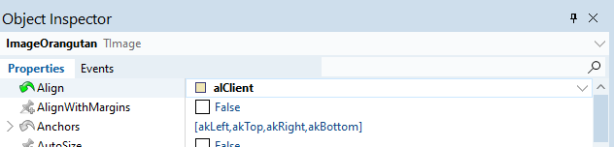
Using TTimer from Vcl.ExtCtrls unit
Notes:
Simplifies parallel computing since two purely functional parts of the evaluation never interact, and a function always returns the same output, given the same input.
Integral Solutions Ltd (ISL) – Poplog = POP 11, Prolog
Clementine (Predictive Analytics Capabilities) sold to SPSS Inc., which sold to IBM Clementine is now IBM SPSS Modeler Professional A demo. It illustrates a class of applications of AI in a business context.

Slide 7
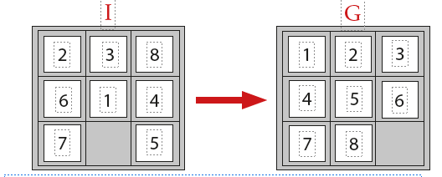
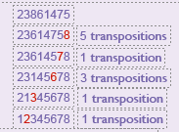
Computability and complexity
Non-computable problem
Eight-puzzle problem.
The puzzle has an initial state I.
The objective is to reach the goal state G from the given initial state I by sliding the numbered tiles where this is possible.
Unfortunately, there is no sequence of steps that will achieve this.
Therefore, any algorithm that attempts to solve this problem will not terminate for the given initial and goal states.
The problem is not solvable, and therefore the problem is non-computable.
The number of transpositions/exchanges required to turn 23861475 into 12345678 is 11, an odd number.
The number of transpositions required to turn 12345678 into 12345678 is 0, an even number.
Odd to even is not possible!
Odd means that after any number of exchanges there will always be at least one tile out of sequence.

Slide 8
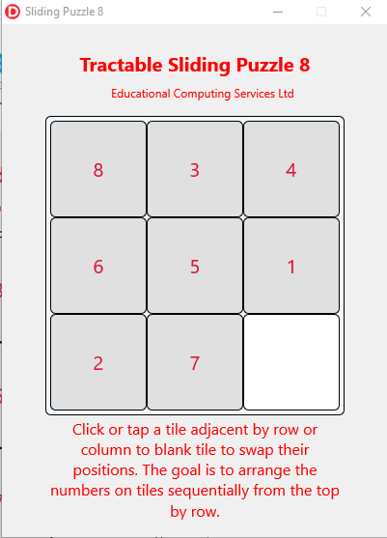
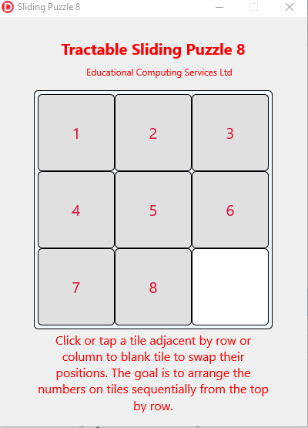
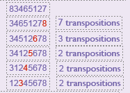
Computable solution
The number of transpositions required to turn 12345678 into 12345678 is 0, an even number.
The number of transpositions required to turn 83465127 into 12345678 is 16, an even number.
Notes:
Integral Solutions Ltd (ISL) – Poplog = POP 11, Prolog
Clementine (Predictive Analytics Capabilities) sold to SPSS Inc., which sold to IBM Clementine is now IBM SPSS Modeler Professional A demo. It illustrates a class of applications of AI in a business context.

Slide 9
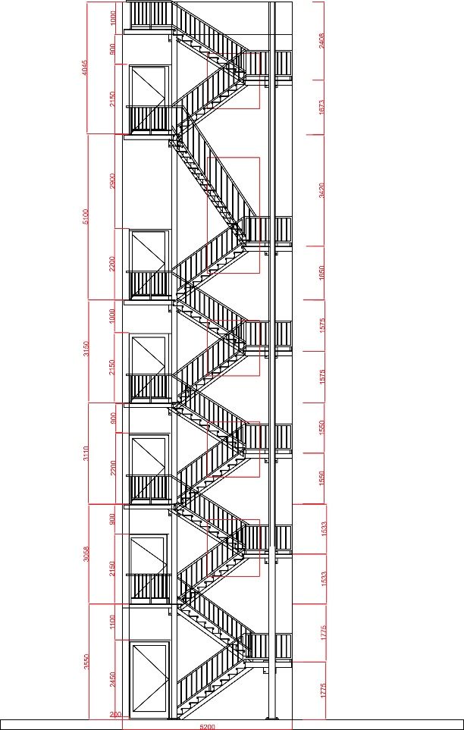
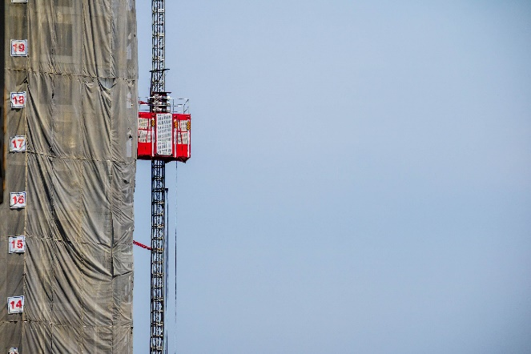
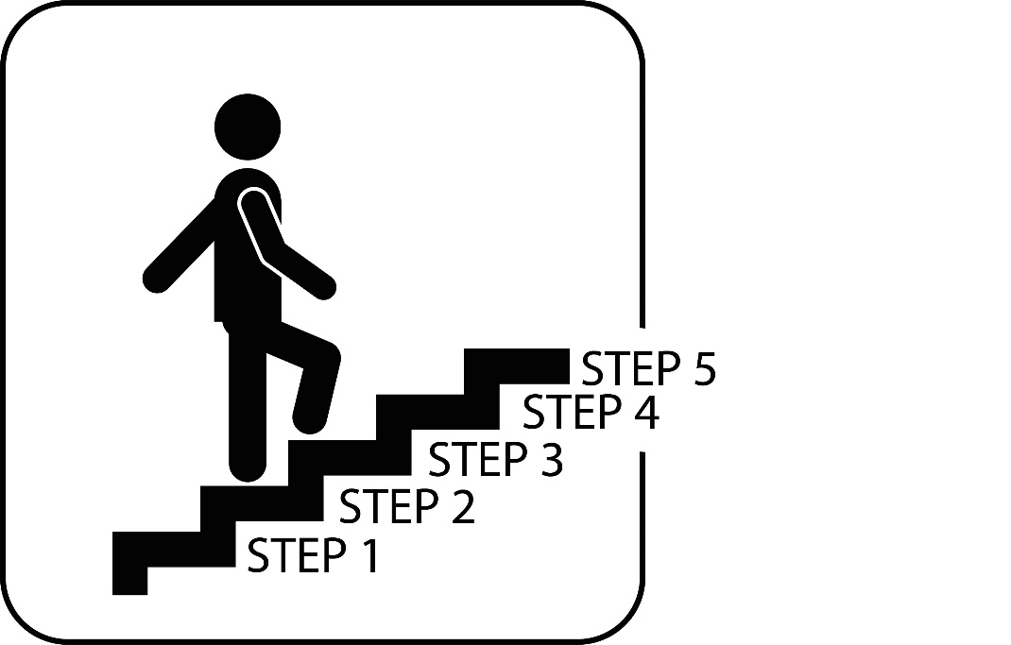
Computability and complexity
Complexity
Even if the problem is an algorithmic problem and it is computable, whether a solution can be produced may still depend on the size of the input and the amount of work that the computer may need to do.
Time efficiency of an algorithm:
The time efficiency of an algorithm is a theoretical time measured by hand in computational steps arrived at by counting the number of steps the algorithm makes to complete a task.
More steps means the algorithm will take longer than another algorithm requiring fewer steps to complete the same task.
© Shutterstock / 63152726
Permission obtained.
© Shutterstock / 349238483. Permission obtained.
More steps means more time consumed
TotalTime = NoOfSteps x StepTime
© Shutterstock / 145794110.
Permission obtained.

Slide 10
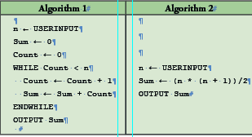
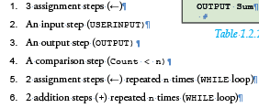
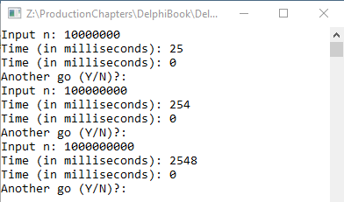
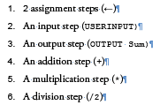
The table shows in pseudo-code two algorithms, algorithm 1 and algorithm 2, for calculating the sum of the first n natural numbers, i.e.
1+ 2 + 3 + 4 + ……(n-1) + n
The first algorithm involves a number of steps which varies with n as follows
The second algorithm involves the following 7 steps whatever the value of n :
Setting aside whether or not each of the different type of steps (assignment, addition, etc) are “worth” different amounts of time, algorithm 1 takes more steps than algorithm 2 to do the same task.
Notes:
Anonymous functions can be used for containing functionality that need not be named and possibly for short-term use. Some notable examples include closures and currying.
The use of anonymous functions is a matter of style. Using them is never the only way to solve a problem; each anonymous function could instead be defined as a named function and called by name. Some programmers use anonymous functions to encapsulate specific, non-reusable code without littering the code with a lot of little one-line normal functions.
In some programming languages, anonymous functions are commonly implemented for very specific purposes such as binding events to callbacks or instantiating the function for particular values, which may be more efficient, more readable, and less error-prone than calling a more-generic named function.
The following examples are written in Python 3.
Sorting
When attempting to sort in a non-standard way, it may be easier to contain the sorting logic as an anonymous function instead of creating a named function. Most languages provide a generic sort function that implements a sort algorithm that will sort arbitrary objects. This function usually accepts an arbitrary function that determines how to compare whether two elements are equal or if one is greater or less than the other.
Consider this Python code sorting a list of strings by length of the string:
>>> a = ['house', 'car', 'bike'] >>> a.sort(key=lambda x: len(x)) >>> a ['car', 'bike', 'house']
The anonymous function in this example is the lambda expression:
lambda x: len(x)
The anonymous function accepts one argument, x, and returns the length of its argument, which is then used by the sort() method as the criteria for sorting.
Basic syntax of a lambda function in Python is
lambda arg1, arg2, arg3, ...: <operation on the arguments returning a value>

Slide 11
Program SumToNLoopingAlgorithm1;
{$APPTYPE CONSOLE}
{$R *.res}
Uses
System.SysUtils, System.Diagnostics;
Var
StopWatch : TStopWatch;
n, Count, Sum : Int64;
Ch : Char;
Begin
StopWatch :=TStopWatch.Create;
Repeat
Write('Input n: ');
Readln(n);
StopWatch.Start;
Count := 0;
Sum := 0;
While Count < n
Do
Begin
Count := Count + 1;
Sum := Sum + Count;
End;
StopWatch.Stop;
Writeln(Format('Time (in milliseconds): %d ', [StopWatch.ElapsedMilliseconds]));
StopWatch.Reset;
StopWatch.Start;
Sum := n*(n + 1) Div 2;
StopWatch.Stop;
Writeln(Format('Time (in milliseconds): %d ', [StopWatch.ElapsedMilliseconds]));
Write('Another go (Y/N)?: ');
Readln(Ch);
Until Ch In ['n', 'N'];
End.
TStopWatch provides a high resolution timer
The accuracy of high-resolution timers is around a few hundred nanoseconds. A nanosecond is a unit of time representing 0.000000001 seconds -- or 1 billionth of a second.

Slide 12

GetTickCount and GetTickCount64
Function GetTickCount and function GetTickCount64 return the number of milliseconds since the operating system started.
GetTickCount returns a 32 bit DWord which wraps every 49.7 days.
Therefore, it is better to use GetTickCount64 (available since Windows Vista) which uses 64 bits.
Unfortunately, the resolution of the system timer which GetTickCount and GetTickCount64 rely upon is typically in the range of 10 milliseconds to 16 milliseconds.
Program GetTickCount64Project;
{$APPTYPE CONSOLE}
{$R *.res}
uses
System.SysUtils,
WinAPI.Windows;
Var
Ticks :UInt64;
Begin
Ticks := GetTickCount64;
Sleep(1000);
{Program execution paused for 1000 milliseconds}
Writeln('ProcessingTime: ',
(GetTickCount64 - Ticks).ToString, ' milliseconds');
Readln;
End.
Program GetTickCountProject;
{$APPTYPE CONSOLE}
{$R *.res}
Uses
System.SysUtils,
WinAPI.Windows;
Var
Ticks :UInt64;
Begin
Ticks := GetTickCount;
Sleep(1000);
{Program execution paused for 1000 milliseconds}
Writeln('ProcessingTime: ',
(GetTickCount - Ticks).ToString, ' milliseconds');
Readln;
End.
Try Sleep(10); Sleep(15);

Slide 13
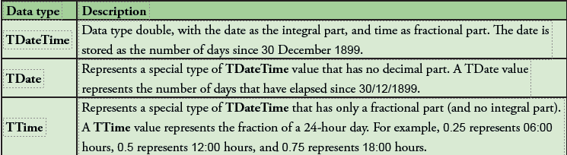
Time and Dates
Values may be dates, e.g. 28/05/2016, or a time of day, e.g. 15:35:16.
Internally, these are just bit patterns.
For these bit patterns to have the meaning date or the meaning time of day, the bit patterns must be data typed.
This requires a data type date and a data type time or a combination of the two, a data type datetime.
Delphi uses the latter and names this data type TDateTime.
TDateTime is defined in the System unit as Type = Type Double;
This form of type definition forces the compiler to create a new distinct type called TDateTime.

Slide 14
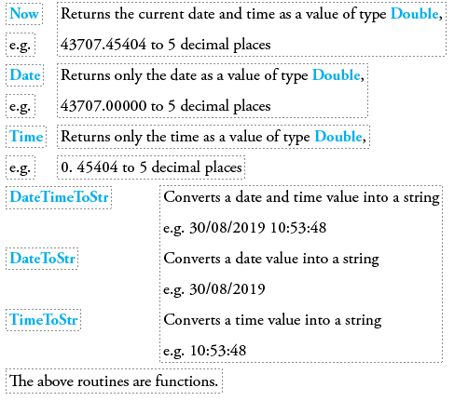
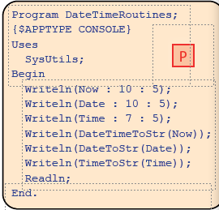
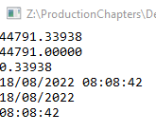
Time and Dates

Slide 15
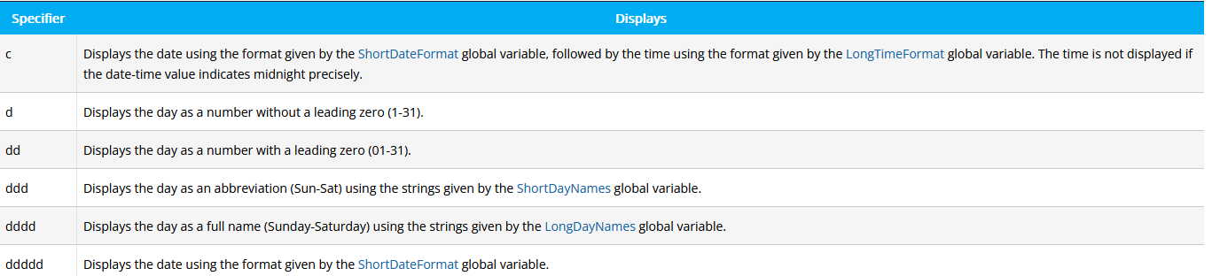
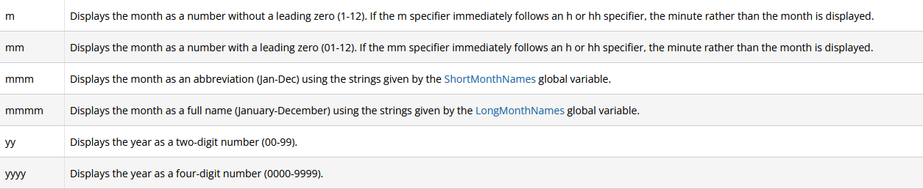
Time and Dates

Slide 16
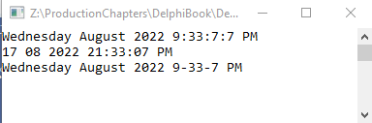
Time and Dates
Program DateTimeWithFormatting;
{$APPTYPE CONSOLE}
{$R *.res}
Uses
System.SysUtils;
Begin
Writeln(FormatDateTime('dddd mmmm yyyy h:n:s:z ampm', Now , FormatSettings));
FormatSettings.DateSeparator := ' ';
FormatSettings.TimeSeparator := ':';
Writeln(FormatDateTime('c ampm', Now , FormatSettings));
FormatSettings.DateSeparator := ' '; FormatSettings.TimeSeparator := '-';
Writeln(FormatDateTime('dddd/mmmm/yyyy h:n:s ampm', Now , FormatSettings));
Readln;
End.
FormatSettings is a global variable of TFormatSettings record type in Delphi which is used to get local information such as DateTimeFormat, CurrencyFormat, DecimalSeparator etc. This variable was introduced in Delphi XE.

Slide 17
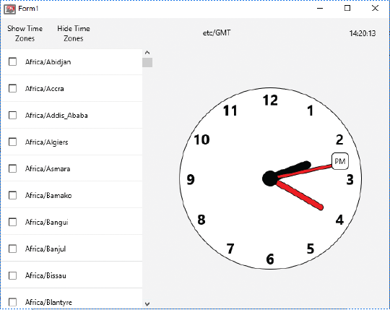
Analogue clock built using FireMonkey components
Procedure TForm1.Timer1Timer(Sender: TObject);
Var
Hour, TwelveHour, Minute, Second : Word;
strHour, strMinute, strSecond : String;
DateTime : TDateTime;
Begin
DateTime := Now;
Hour := HourOf(DateTime);
TwelveHour := Hour Mod 12;
Minute := MinuteOf(DateTime);
Second := SecondOf(DateTime);
rrHour.RotationAngle := 30 * TwelveHour + Round(Minute/2.17);
rrMinute.RotationAngle := 6 * Minute;
rrSecond.RotationAngle := 6 * Second;
strHour := Hour.ToString;
strMinute := Minute.ToString;
strSecond := Second.ToString;
If (Length(strMinute) < 2)
Then strMinute := '0' + strMinute;
If (Length(strSecond) < 2)
Then strSecond := '0' + strSecond;
If (Length(strHour) < 2)
Then strHour := '0' + strHour;
Text3.Text := strHour + ':' + strMinute + ':' + strSecond;
End;
Based on an idea from Harry Stahl’s book Cross-Platform Development with Delphi 10.2 & FireMonkey.
With Harry’s permission extended this cross-platform application by adding time zones.

Slide 18
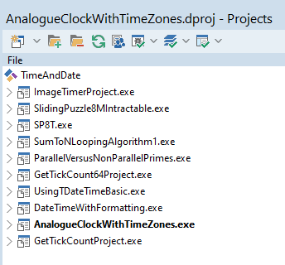
Download information for programs used in this presentation
Source code for these programs may be downloaded from a url supplied by contacting drbond@educational-computing.co.uk or from the LearnDelphi.org site. Look for the .zip extension of the following

